Slide 1
Aspect Oriented Programing
Present : Dao Duc Thinh

Slide 2
Content
What is AOP ?
Why use AOP ?
How use AOP ?
Spring AOP and AspectJ
Demos

Slide 3
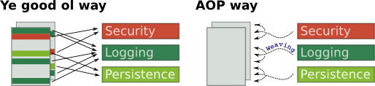
What Is AOP
What is Aspect Oriented Programming (AOP) A programming paradigm that aims to increase modularity by allowing the separation of cross-cutting concerns. It does so by adding additional behavior to existing code (an advice) without modifying the code itself”

Slide 4
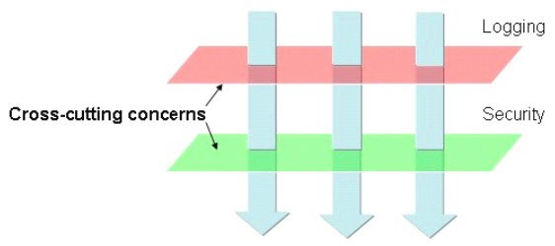
What Is AOP
Crowcutting concern

Slide 5
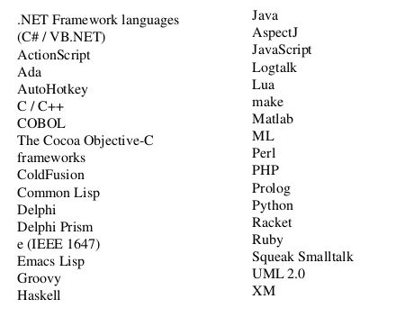
AOP Implement Languges

Slide 6
AOP concept
Join Point :
Place where behaviour can be added
Advice :
Code that can be injected at join points
Point cut :
Join points where advice should be applied
Aspect :
Container holding point cuts and advice
Weaving :
Combines advices with point cuts

Slide 7
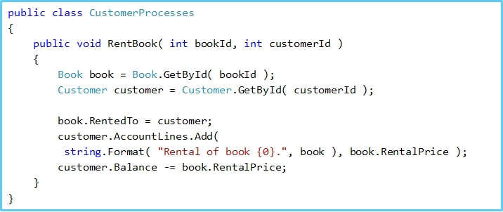
Why Use AOP

Slide 8
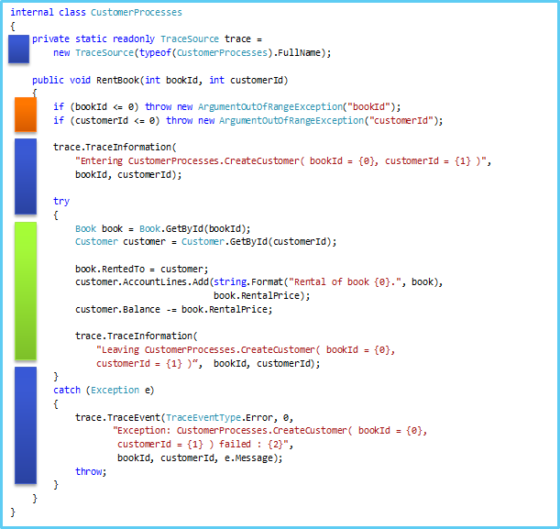

Slide 9
Why Use AOP
Code tangling and scattering
Poor traceability
Lower productivity
Less code reuse(Boilerplate code)
Harder refactoring
High-coupling
=> AOP solution.

Slide 10


Coding is HARD
AOP makes it EASY

Slide 11
Usages Of AOP
Usages of AOP AOP can be used for a multitude of purposes
Loging
Auditing
Transactions
Sercurity
Caching

Slide 12
How does AOP work
AOP works by intercepting methods that comply to certain parameters (pointcuts), and executing a callback wrapper (advice).

Slide 13
Approaches to Weaving
Static Weaving
Compile time
Post-compile time
Dynamic Weaving
Loading time
Runtime

Slide 14
Static Weaving
Compile time : compile either target source or aspect classes via the AspectJ compiler.
Post compile time : Inject aspect instructions to already compiled classes.

Slide 15
Dynamic Weaving
Load time weaving : Inject aspect instructions to the byte code during class loading.
Runtime weaving: Through proxy using concept of dynamic proxy if interface exists or cglib library if direct implementation provided

Slide 16
Spring AOP and AspectJ
Spring AOP : Dynamic weaving.
Runtime.
Spring with AOP support: AspectJ weaving.
Dynamic + Static waeving.

Slide 17
Spring AOP
Spring AOP framework comes with certain limitations in comparison .
Aspects do not apply to intra–operation calls
Proxy – based : If the target object to be proxied implements at least one interface then a JDK dynamic proxy will be used. All of the interfaces implemented by the target type will be proxied. If the target object does not implement any interfaces then a CGLIB proxy will be created
Only support method.
Add aspect required object created by Spring factory

Slide 18
Spring with AOP support
This supports all pointcuts. This means you can do anything.
There is less runtime overhead than that of Spring AOP.
You need extra build process with AspectJ Compiler or have to setup LTW (load-time weaving)

Slide 19
Spring + AspectJ weaving

Slide 20
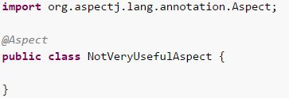
AOP Syntax
@Aspect
Declare Aspect.
Is class annotation.

Slide 21
AOP Syntax
@Pointcut : pointcuts determine join points of interest. A pointcut declaration has two parts
A signature comprising a name and any parameters
A pointcut expression that determines exactly which method executions we are interested.
execution(modifiers-pattern? ret-type-pattern declaring-type-pattern?name-pattern(param-pattern) throws-pattern?)

Slide 22
AOP Syntax - @Pointcut
Some main designators
execution : for matching method execution join points,
within : limits matching to join points within certain types
this : limits matching to join points (the execution of methods when using Spring AOP) where the bean reference (Spring AOP proxy) is an instance of the given type
target : limits matching to join points (the execution of methods when using Spring AOP) where the target object (application object being proxied) is an instance of the given type

Slide 23
AOP Syntax - @Pointcut
Some main designators (continue)
args - limits matching to join points where the arguments are instances of the given types
@target - limits matching to join points where the class of the executing object has an annotation of the given type
@args - limits matching to join points where the runtime type of the actual arguments passed have annotations of the given type(s)
@within - limits matching to join points within types that have the given annotation
@annotation - limits matching to join points where the subject of the join point has the given annotation

Slide 24
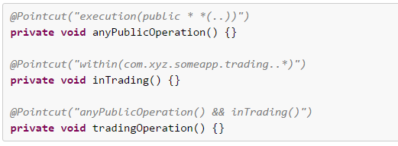
AOP Syntax - @Pointcut
Combining pointcut expressions.

Slide 25
AOP Syntax - @Pointcut
Common pointcut expressions
execution(public * *(..))
execution(* set*(..))
execution(* com.xyz.service.AccountService.*(..))
execution(* com.xyz.service.*.*(..))
execution(* com.xyz.service..*.*(..))
within(com.xyz.service.*)
within(com.xyz.service..*)
this(com.xyz.service.AccountService)
target(com.xyz.service.AccountService)
args(java.io.Serializable)
@target(org.springframework.transaction.annotation.Transactional)
@within(org.springframework.transaction.annotation.Transactional)
@annotation(org.springframework.transaction.annotation.Transactional)
@args(com.xyz.security.Classified)

Slide 26
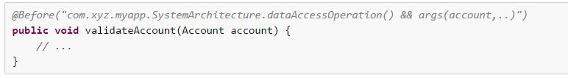
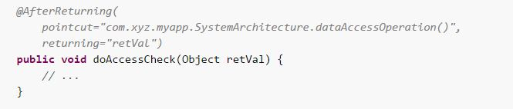
AOP Syntax
Advice
@Before
@AfterReturning

Slide 27
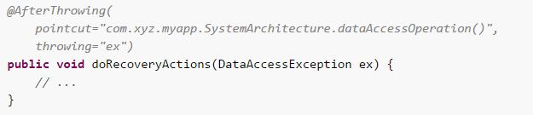

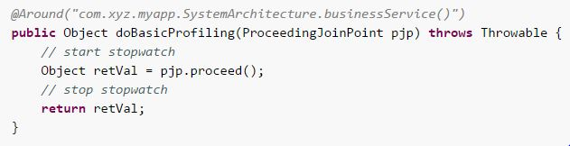
AOP Syntax - Advice
@AfterThrowing
@After
@Around

Slide 28
Demo

